Slide 1
The REAL Moneyball
Machine Learning and Predictive Analytics
University of Chicago
December 11, 2020

Slide 2
Agenda
Background/Problem Statement
Assumptions/Hypotheses/Limitations
EDA
Data Properties & Transformations
Proposed Approaches (# Models)
Proposed Solution (Model Selection)
Results (Accuracy, Overfitting/Underfitting)
Future Work (Model Improvement)

Slide 3
Background/Problem Statement
In 2015 MIT team earned $15,000 on Daily Fantasy NHL in 11 weeks
Used a combination of RotoGrinders and Daily Fantasy Nerd predictions
Built an optimization algorithm, making lineup selection
“Picking Winners in Daily Fantasy Sports Using Integer Programming”
Problem statement: develop ML model(s), outperforming MIT result and using baseball data
Notes:
https://arxiv.org/abs/1604.01455

Slide 4
Assumptions/Hypotheses/Limitations
Mike is the right person here to answer
Can be split into separate slides, if necessary
Notes:
https://arxiv.org/abs/1604.01455

Slide 5

Authors’ results/Project baseline
Notes:
https://arxiv.org/abs/1604.01455

Slide 6
Data Preparation
We need Mike here to go through the whole process of data prep
Notes:
https://arxiv.org/abs/1604.01455

Slide 7
Data description (initial, updated, final)
Sources: Retrosheet.org
Size:
Quality: no missing values
Else:
Notes:
https://arxiv.org/abs/1604.01455

Slide 8
Exploratory Data Analysis
Skewed distribution of a target variable
No StandardScaler
Notes:
https://arxiv.org/abs/1604.01455

Slide 9
Feature engineering
Total variables:
Numeric and some categorical
Problem: high collinearity between multiple variables
Notes:
https://arxiv.org/abs/1604.01455

Slide 10
Model EDA with PyCaret
Advantages:
Low code Python library
High level overview of regression models and their results
Ideas for exploration (accuracy vs time)
Disadvantages:
Blackbox solution
Notes:
https://arxiv.org/abs/1604.01455

Slide 11
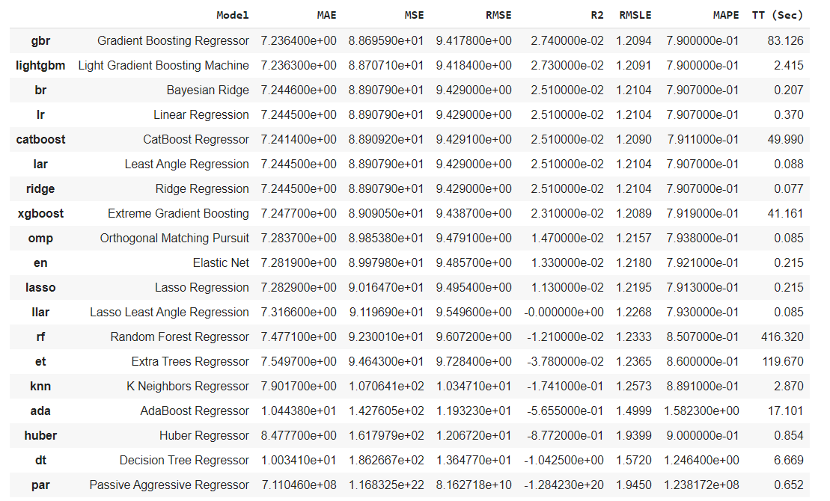
PyCaret overview
Notes:
https://arxiv.org/abs/1604.01455

Slide 12
Improve the table and highlight points
Notes:
https://arxiv.org/abs/1604.01455

Slide 13
Selected supervised learning models
Boosting algorithms:
Gradient Boosting
Light Gradient Boosting Machine
Regressions:
Linear Regression
Ridge Regression
Notes:
https://arxiv.org/abs/1604.01455

Slide 14
Explain each model per slide
Metrics
Accuracy vs speed
Limitations
Else
Notes:
https://arxiv.org/abs/1604.01455

Slide 15
Advanced Analysis
Mike’s ideas
Implementation
Notes:
https://arxiv.org/abs/1604.01455

Slide 16
PCA analysis
Serena might take a look here
Notes:
https://arxiv.org/abs/1604.01455

Slide 17
Neural networks
4 simple NNs (TBD)
Explain advantages and disadvantages
Compare metrics vs time
Notes:
https://arxiv.org/abs/1604.01455

Slide 18
Sources
Mike’s ideas
Implementation
Notes:
https://arxiv.org/abs/1604.01455

Slide 19
Future work
TBD
Notes:
https://arxiv.org/abs/1604.01455

Slide 20


Our Team
Serena Hanwen Xu
Adrienne Wang
Oleksiy Anokhin​
Mike Thompson

Slide 21
Q & A

